Slide 1


Sketchly
From sketch to site.
HHCC 2026 · Prototype Development Track · Team 26​

Slide 2
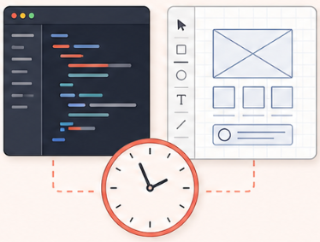
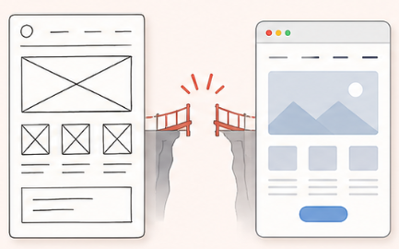
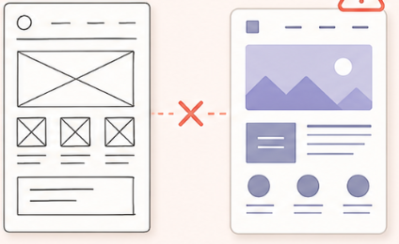
The Problem
A website idea is easy to find, but making an actual webpage is tough.
1
2
3
Conventional website design is inefficient
Building websites starts from scratch
Common AI tools tend to guess, lacking true understanding
Rough sketches cannot directly become usable interfaces
Every website concept requires interface design and front-end expertise
Prompt-based generators often miss layout/design intent

Slide 3
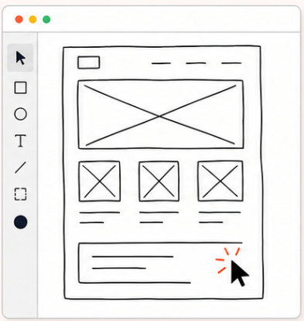
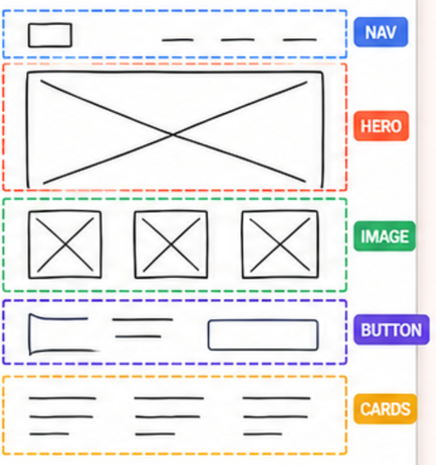
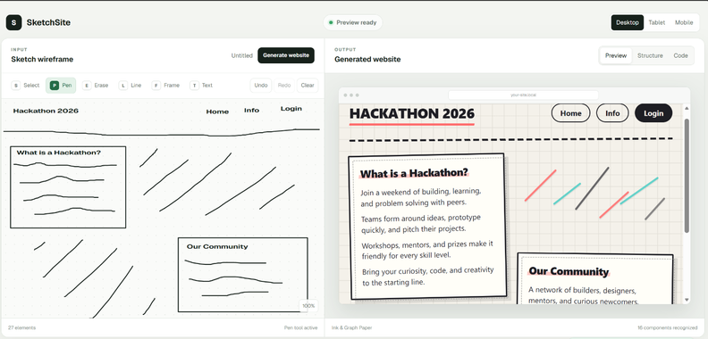

Our Solution
Sketchly – turns a sketch into a working interface in real time.
1
2
3
Draw naturally
We can recognize the intended structure
Generate, Refine, Export
It’s simple. Sketch with anything.
Machine vision recognizes components, layout, and hierarchy.
Preview designed pages and export usable code with full transparency.

Slide 4

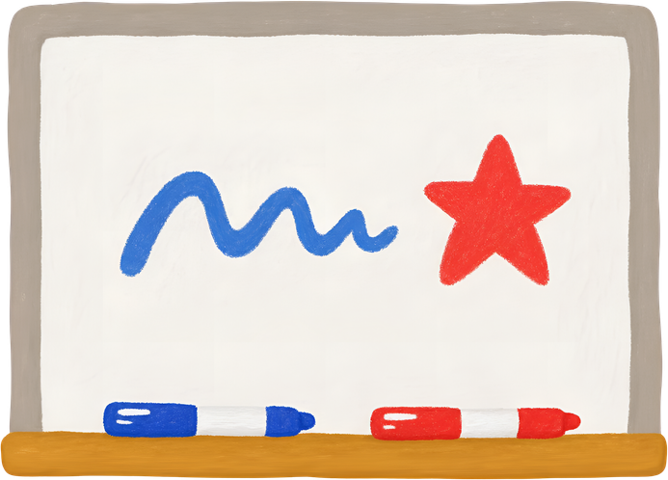
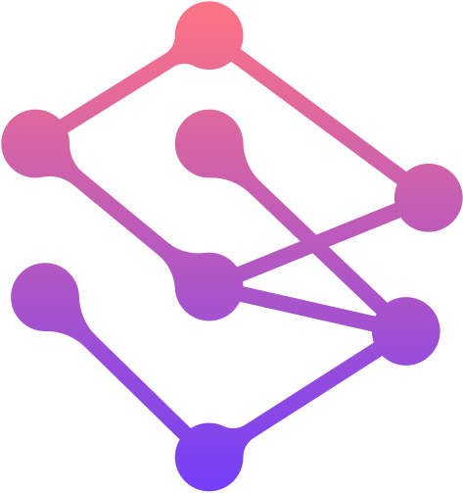

Core Components
Canvas - user friendly drawing experience.
Two modes of generation:
Real-time
Generative AI
Changeable style of the website (css)
Viewable website structure and code

Slide 5
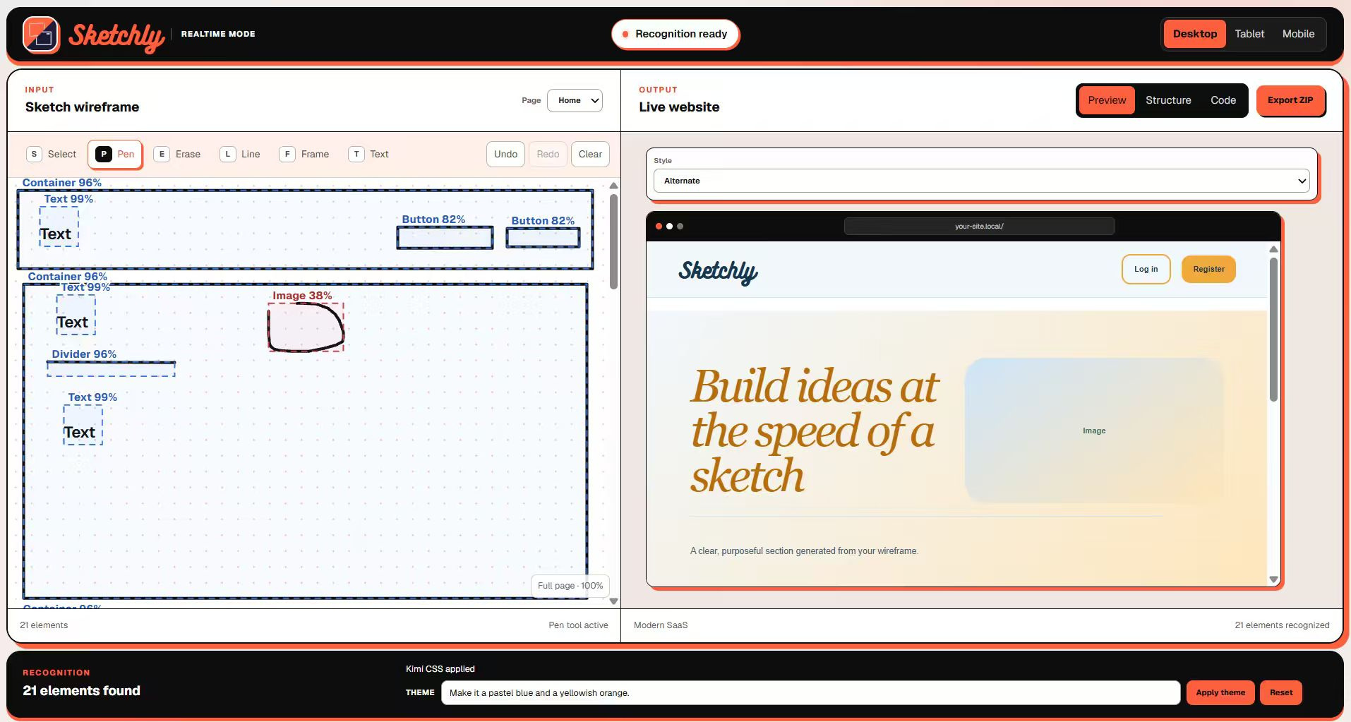
Product Concept
Left-hand side: Sketching canvas
Right-hand side: live generated website entirely based on the canvas, updating as you draw.

Slide 6
Functionality – Real-time Mode
DRAW
PREPARE
CLASSIFY
Strokes become UI primitives
(Text·Button·Input·Image·Container)
Sketch website by pen·line·frame·text
Recognition starts automatically
EDIT
The user can change what component something is
The user can also use generative AI to change the style of the webpage freely.
INFER
OUTPUT
Stroke context predicts component function
(Navbar·Hero·Cards·Form·Footer)
Website updates immediately

Slide 7
Functionality – Generative Mode
DRAW
UPLOAD
DRAW
ANALYZE
RECOGNIZE
User can sketch the
website by the provided
tools of the canvas
Click “generate website”,
upload the canvas
Choice to input a theme to change the style of the website
Sketch website by pen·line·frame·text
Recognition starts automatically · 1000ms
Identify the objects and their position
OUTPUT
CORRECT
INFER
OUTPUT
GENERATE
CONVERT
The user verifies the interpretation
Stroke context predicts component function
(Navbar·Hero·Cards·Form·Footer)
Website updates immediately
Convert into json structure for further generation
Update the generated website
Generate the code for the website

Slide 8




Our Competitive Edge
Transparent & Accessible
Deterministic · Local-first software · Confident Machine Vision
Free · Occasional erroneous output
Recognition Inaccuracy
Consistency & Accuracy
Cloud-dependent · Paid account · Opaque
Opaque & Costly
Varied output · Doesn’t show confidence

Slide 9
Branding and Business Plans
Our Slogan
Business Plan
“The tool to create websites straight from your imagination”
Our business plan is to charge the use of generative AI through a subscription service.
This ensures a good user experience even if the user doesn’t pay, but also convinces the user to pay more, once they want more features.

Slide 10



Social Impacts
1
2
3
Lowers barrier to website building
Cost-friendly
Retains creativity
Accessible for large amounts of people, and the Realtime mode is completely free.
Users can adjust interface components and the theme style.
Anyone who can sketch can produce a website prototype.

Slide 11
Future plans
Adding more functions based on user feedback
1
Model training for more accurate results
2
Seek investment to enhance our models
3
Advertising
4

Slide 12
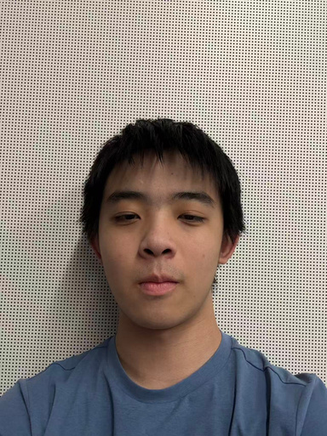
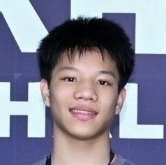




Team Roles
Jason Huang
Brian Chen
Henry Liu
黄彦哲
陈晢朴
刘烨亨
Head of Product and Marketing
Head of Technical Development
Head of Design and Interaction
Tiger Yin
Patrick Liu
殷泰格
刘澎宇
Head of Presentations, Videos, and Roadshows
Head of Testing and Demonstration

Slide 13
THANK YOU
We are happy to answer any questions.

